Slide 1

Web Scraping II

Slide 2
Recap of
Web Scraping I
Final 3 Data Frames From Previous Tutorial Should All Be Saved to CSV’s on PC
  FINAL_VIOLENT.CSV
  FINAL_ZIP.CSV
  FINAL_STATE_ABBREV.CSV
Think About What Other City Information Could Potentially Be a Factor in Violent Crimes
Think About What Other City Information Could Potentially Be Influenced by the Prevalence of Violent Crimes

Slide 3
Tutorial
Introduction
Step 1: Open Tutorial
Step 2: Ensure You Have the Following R Packages Installed
  tidyverse
  rvest (Requires Internet)
Step 3: Switch Knitter
Step 4: Read the Introduction

Slide 4
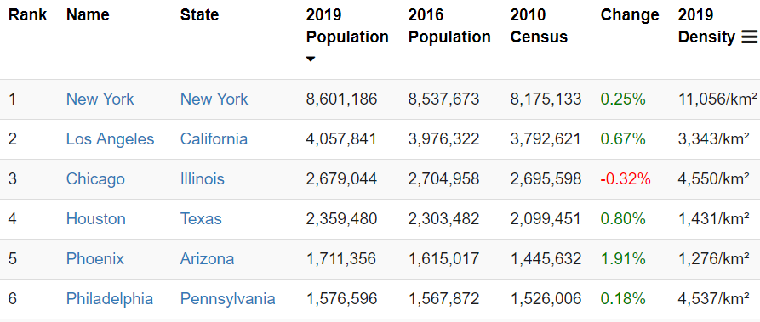
Part 1:
Connection to Population Change and Density
Step 1: Select the Link and Observe the Following Table
Step 2: Questions?
  What is the Connection to Violent Crimes?
  How is this Useful When Related to Violent Crimes?

Slide 5
Part 1:
Connection to Population Change and Density
Step 3: Run Chunk 1
  What is required to convert the Percentage Change to a numeric variable?
  What is required to convert the 2019 Density to a numeric variable?
Step 4: Run Chunk 2
  Notice: /.*
Step 5: No-Knitter

Slide 6
Part 2:
Inclusion of
Expert Opinion
Step 1: Selector Gadget Website
  Open Source
  Chrome Extension Exists
  Easy: Drag Link to Bookmark Bar as Webpage Explains
Step 2: Observe the Article on 2018’s Safest and Most Dangerous States
  What info could be of use?
  Do you agree identification?

Slide 7
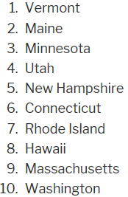
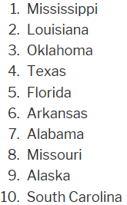
Part 2:
Inclusion of
Expert Opinion
Step 3: Information of Interest
  Safe vs Dangerous
  Goal: Scrape this Information into Vectors in R to Create a Table

Slide 8
Part 2:
Inclusion of
Expert Opinion
Step 4: Identifying CSS Selector
  Go to Web Page
  Choose SelectorGadget in Bookmark Tab
  Locate This Box

Slide 9
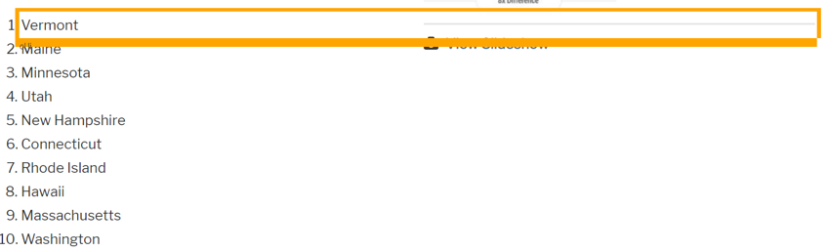
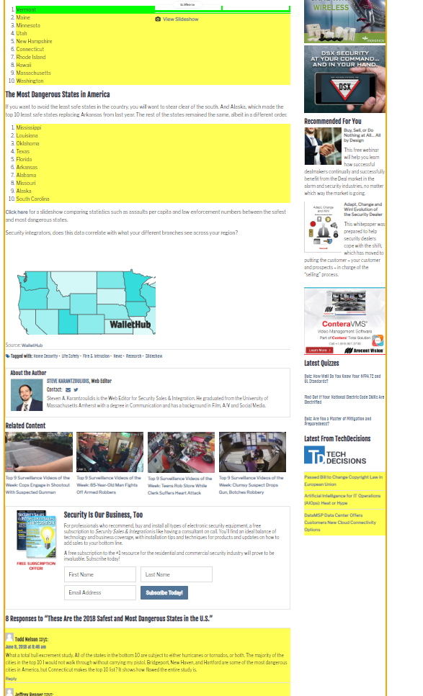
Part 2:
Inclusion of
Expert Opinion
Step 4: Continued
  Find Content You Want
  Point and Click
  to Select Info
  Info We Want is
  Highlighted
  Info We Don’t
  Want, As Well
Hover Over Text We Want

Slide 10
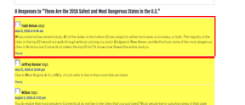
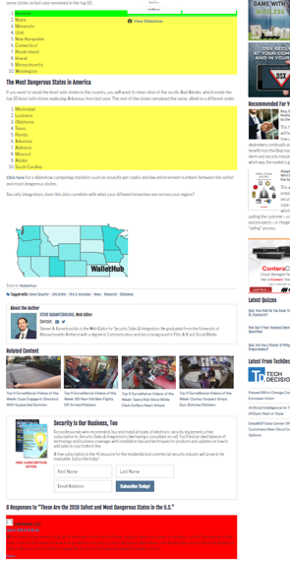
Part 2:
Inclusion of
Expert Opinion
Step 4: Continued
  Find Content You Don’t Want
  Point and Click
  to Deselect
  Locate This Box
Hover Over Text We Don’t Want

Slide 11
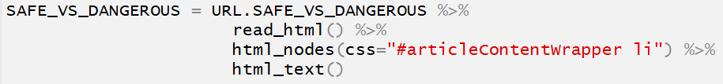
Part 2:
Inclusion of
Expert Opinion
Step 4: Continued
  Locate This Box
  Copy CSS Selector
  “#articleContentWrapper li”
Step 5: Run Chunk 1
Step 6: Run Chunk 2
  What About the Other States?
Step 7: Walk-off Knit

Slide 12
Closing
Disperse and Make Reasonable Decisions

